Slide 1
Development project „Nordplus Conservatoire“
NordClassic network

Slide 2
Synchronous and asynchronous modules / digital education:
18 partner institutions (Dev. project information)
Active members – module developers:
Centria Polytechnic University of Applied Sciences
Estonian Academy of Music and Theatre (website developer)
Jazeps Vitols Latvian Academy of Music
Lithuanian Academy of Music and Theatre (coordinating institution)
Metropolia University of Applied Sciences
Oulu University of Applied Sciences
Royal Danish Academy of Music
Tampere University of Applied Sciences

Slide 3
List of online courses:
Nordic Noir / music history course (DKDM)
Identity Branding for Afrtists (LMTA)
Preparing for Orchestral Audition (CUAS)
Identity Branding for Artists (LMTA)
Analysis and Composition of Popular Genres (LMTA)
MAPSI, Managing Art Projects With Societal Impact (EMTA)
Electroacoustic Music History (EMTA)
History of Audiovisual Art (EMTA)
Introduction to Sound Theory and AV Recording (EMTA)
Building Your Creative Career: Designing, Funding, and Negotiating in the Arts (CENTRIA)

Slide 4
List of online courses:
Preparing for Orchestra Musician (KOKKOLA)
Improvisational Skills for Musicians and Music Pedagogues (CENTRIA)
Contemporary Music Performance Practice (METROPOLIA)
French Phonetics and Diction for Classical Singers (METROPOLIA)
Healty Musician (JVLMA)
AI in Music, Theatre and Film (LMTA)
Music and Moving Images / joint module (LMTA & VDA)
Ear Training (LMTA)
Contemporary Music Analysis (LMTA & JVLMA)
Music Technology 101 (LMTA & TAMK)
Spatial Sound (LMTA)

Slide 5
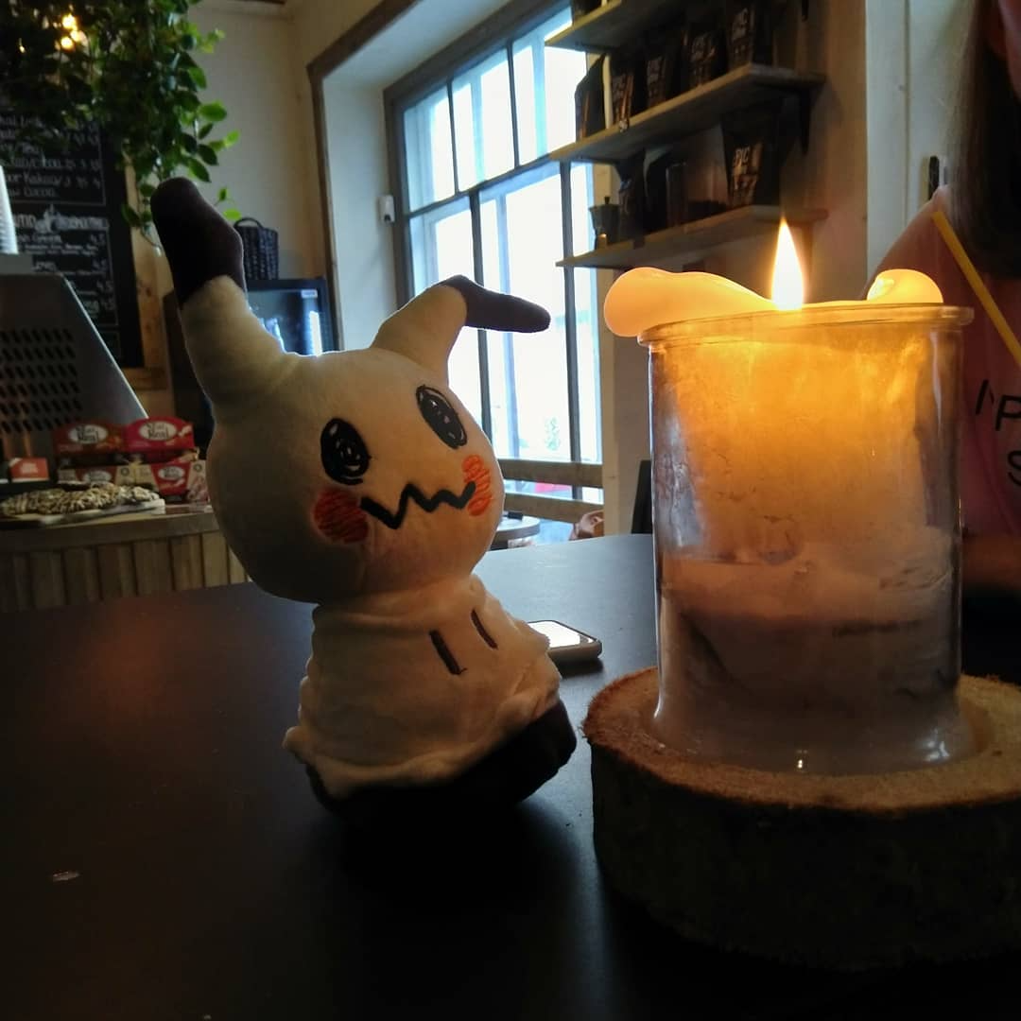
https://nordplusconservatoire.net/

Slide 6

Development of visuals
Menti.com
8809 7958

